Slide 1


Seattle
Housing Price
Prediction
Team 2
REDACTED
REDACTED
Loc Le
REDACTED

Slide 2
Table of Contents
01.
02.
03.
04.
Analytics Question
Dataset Description
Business Problem &
Case
Descriptive Analytics
05.
06.
07.
08.
Modeling Methods & Specifications
Analysis of Results
Conclusions
Challenges & Lessons Learned

Slide 3

01.
Business Problem & Case

Slide 4
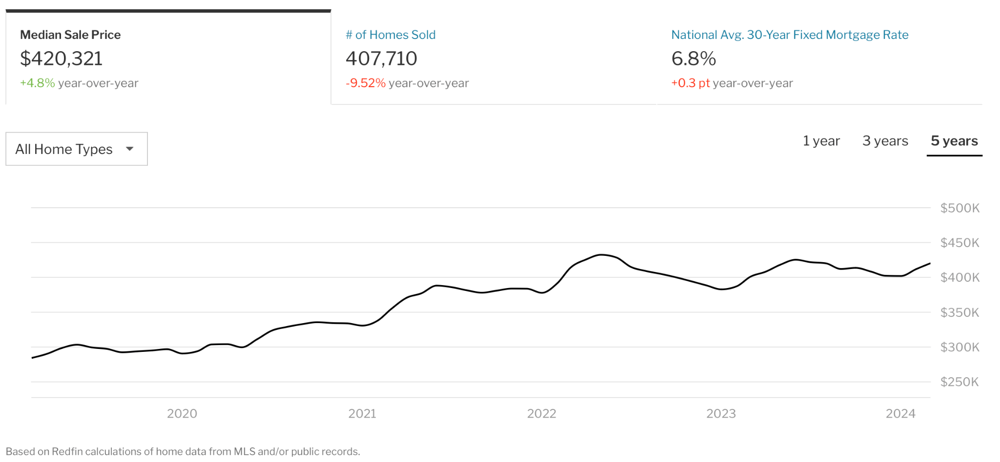
Business Case
Home prices are rapidly rising in Seattle due to a lack of housing supply and increased demand
The overall housing supply remains low
Experts predict an increase in homes selling for more than the asking price

Slide 5
Business Question
For real estate agents or individuals looking to sell a house in Seattle, what are the most important home features to consider when predicting the sales price?

Slide 6
02.
Analytics Question

Slide 7

Analytics Goal: Predictive Accuracy & Interpretation
Analytics Question: What effect does the most important features of a house have on its selling price?
Response Variable: Price
Quantitative | Categorical | Binary
Price | View | Waterfront
Bedrooms | Condition | Renovated
Bathrooms | Grade
Sqft_living
Sqft_lot
Floors
House_age

Slide 8
03.
Dataset
Description

Slide 9


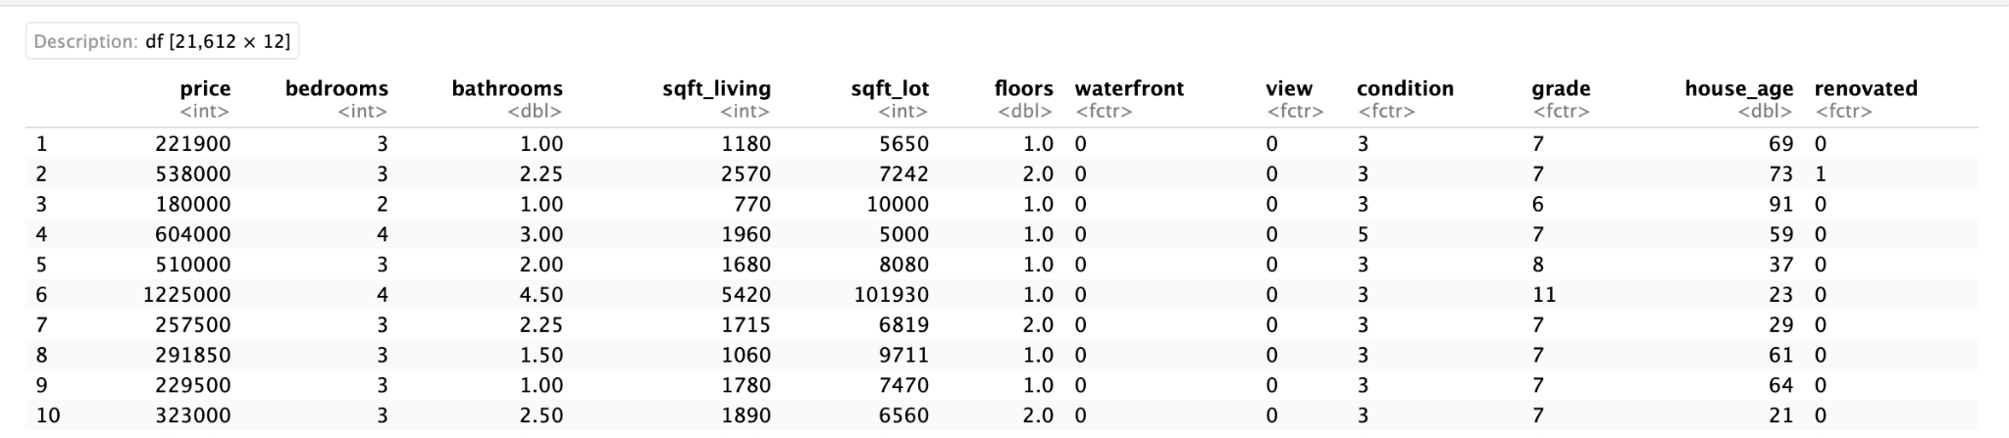
Seattle House Sales Prices from Kaggle (21,613 entries with 21 variables)
Checked for data cleanliness
No missing values found
Identified and removed outlier: a house with 33 bedrooms
Created "house_age" variable
2024 - “yr_built”
Created binary variable "renovated"
0 indicates no renovation ("yr_renovated" = 0)
1 indicates renovated ("yr_renovated" ≠ 0)
Removed unnecessary variables
Converted variables to proper data types

Slide 10
04.
Descriptive Analytics

Slide 11
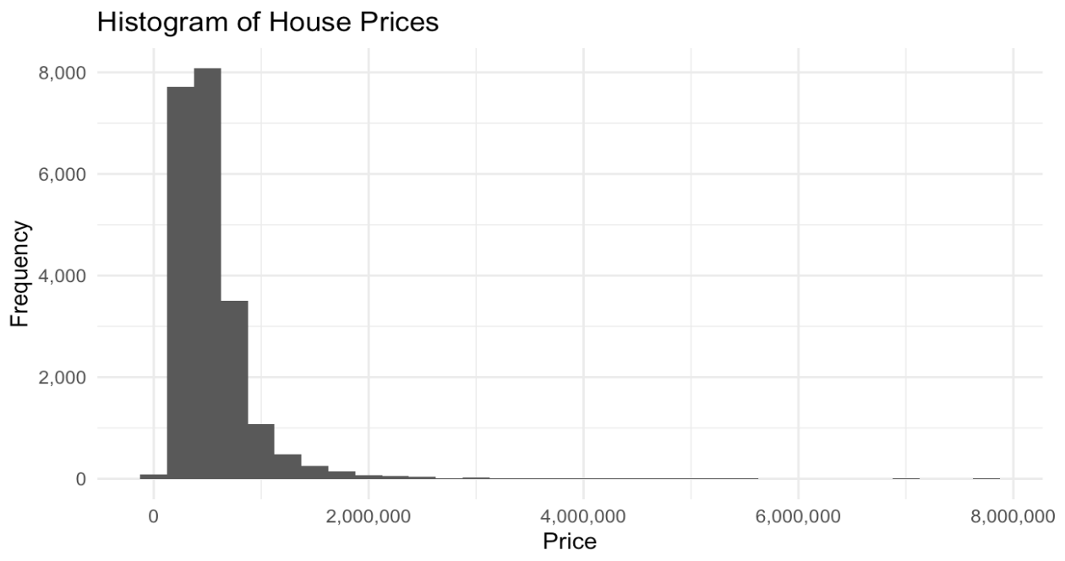
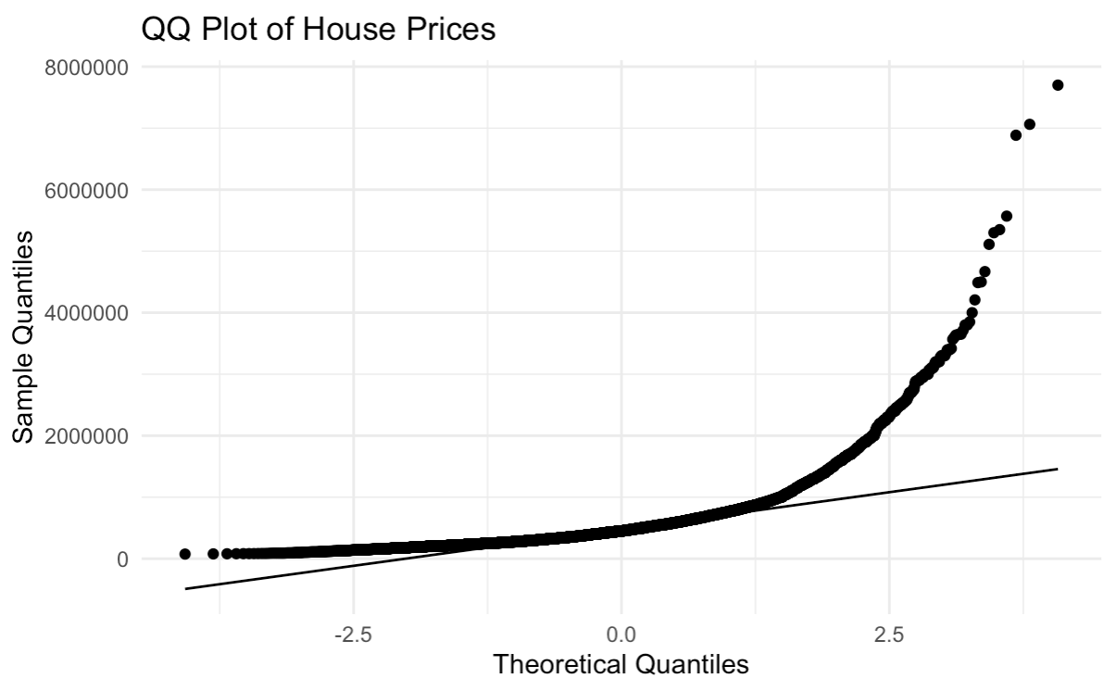
Response Variable
Price is right-skewed and does not follow a normal distribution

Slide 12
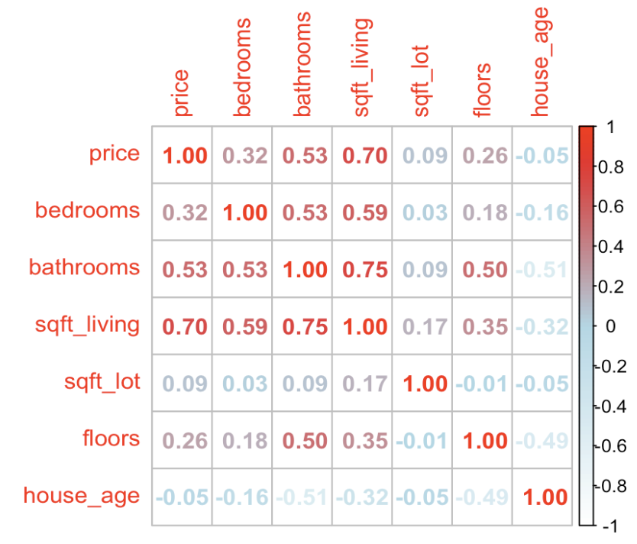
Quantitative Variables
Sqft_living (0.70) has the strongest positive correlation with price while house_age (-0.05) has the weakest negative correlation

Slide 13
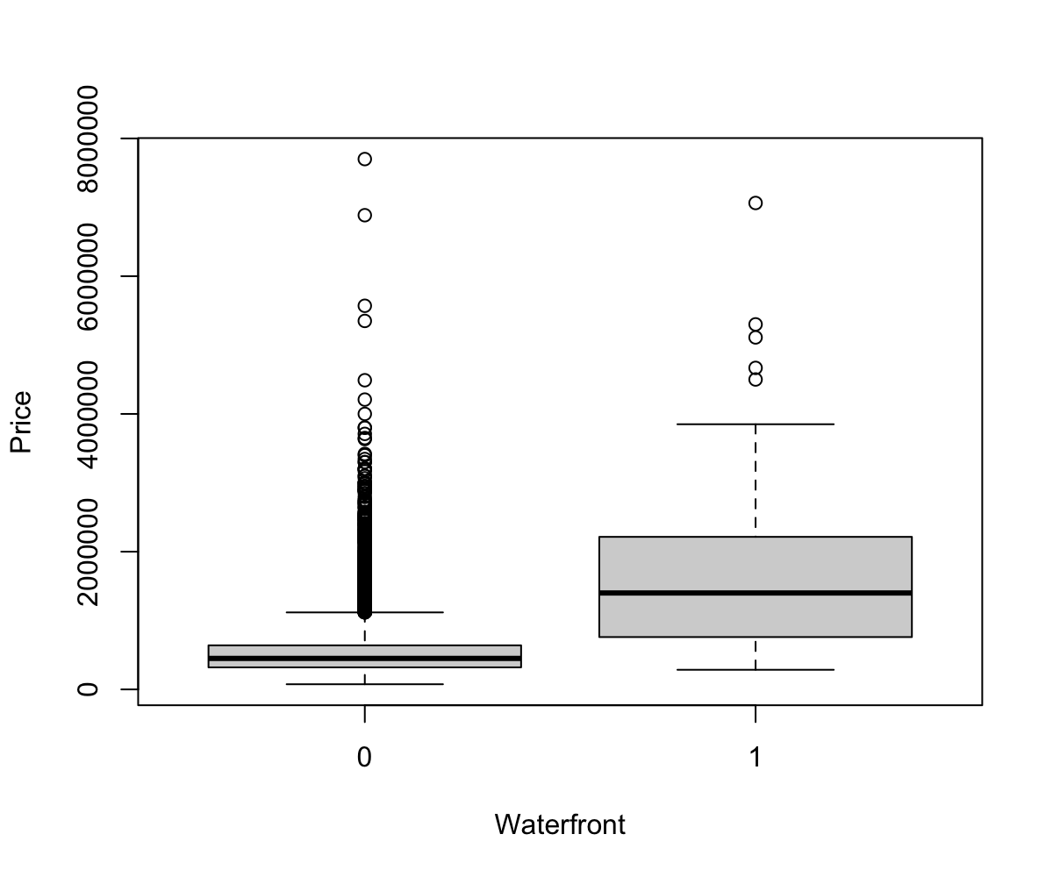
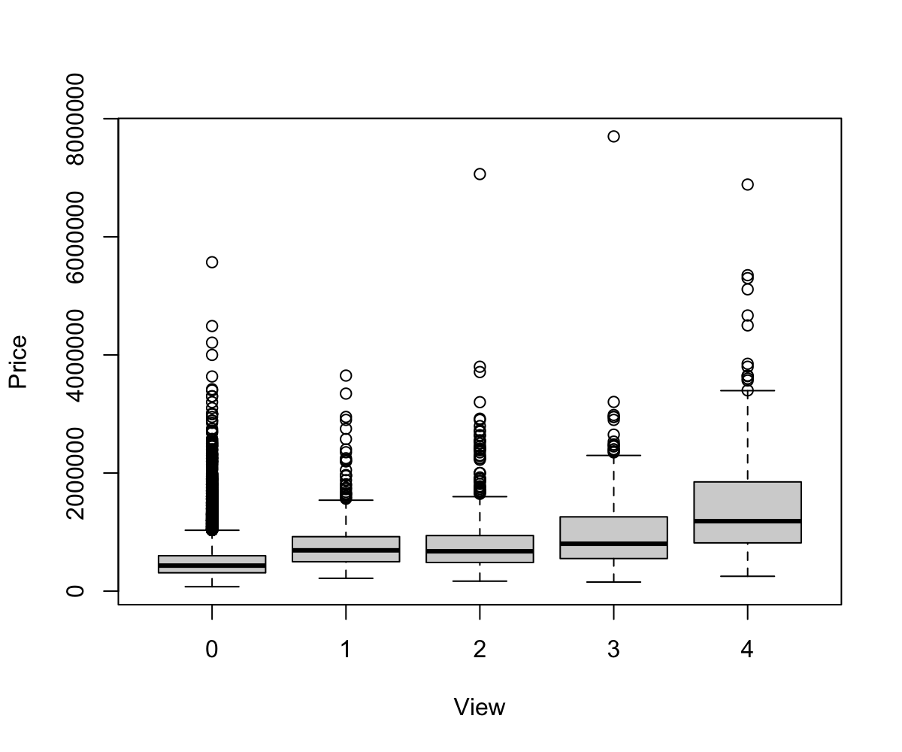
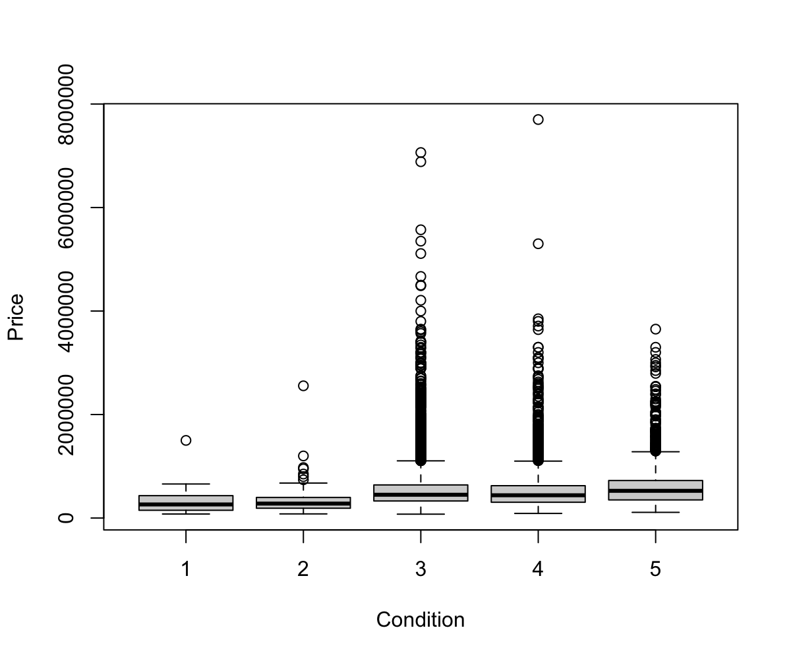
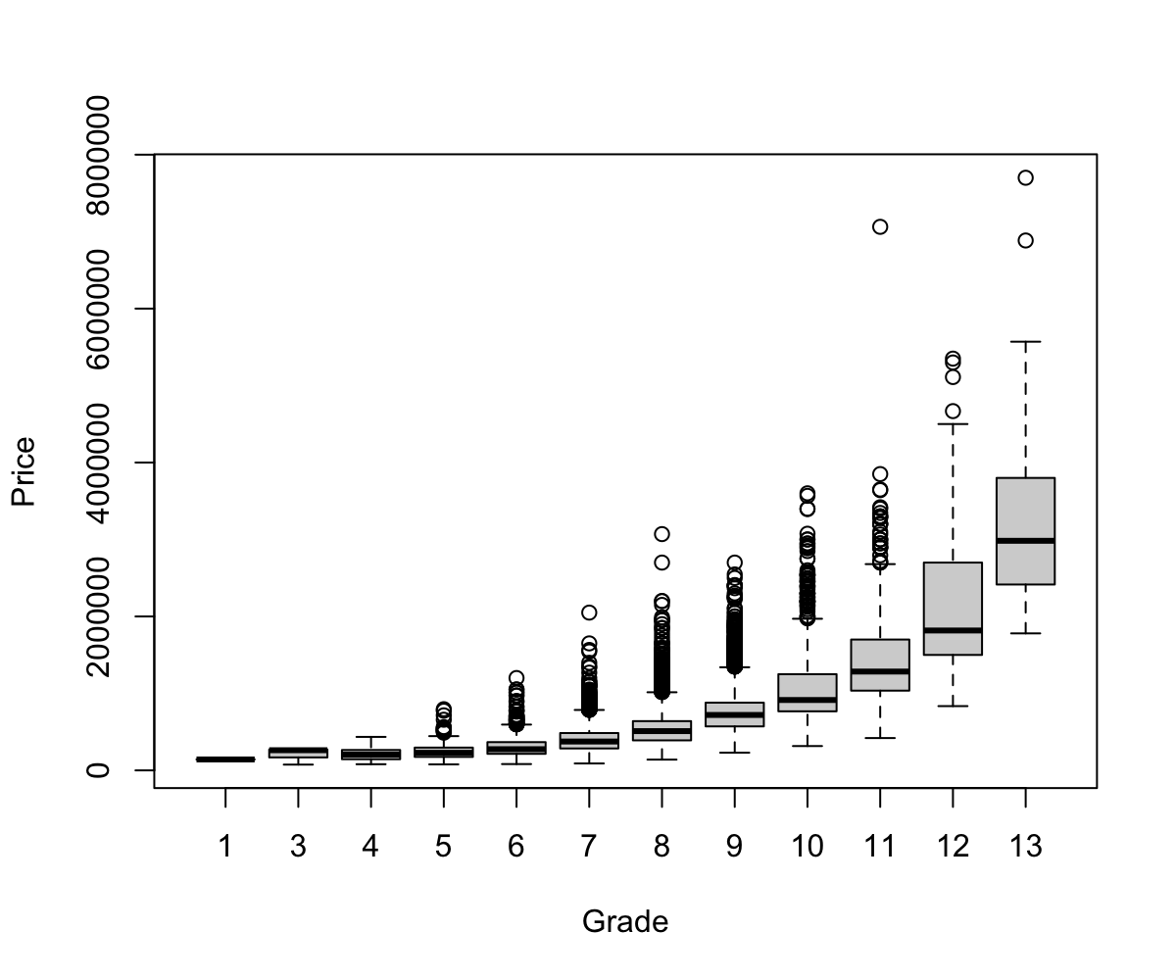
Categorical Variables
Price varies across different groups for our categorical variables of interest

Slide 14
05.
Modeling Methods & Specifications

Slide 15
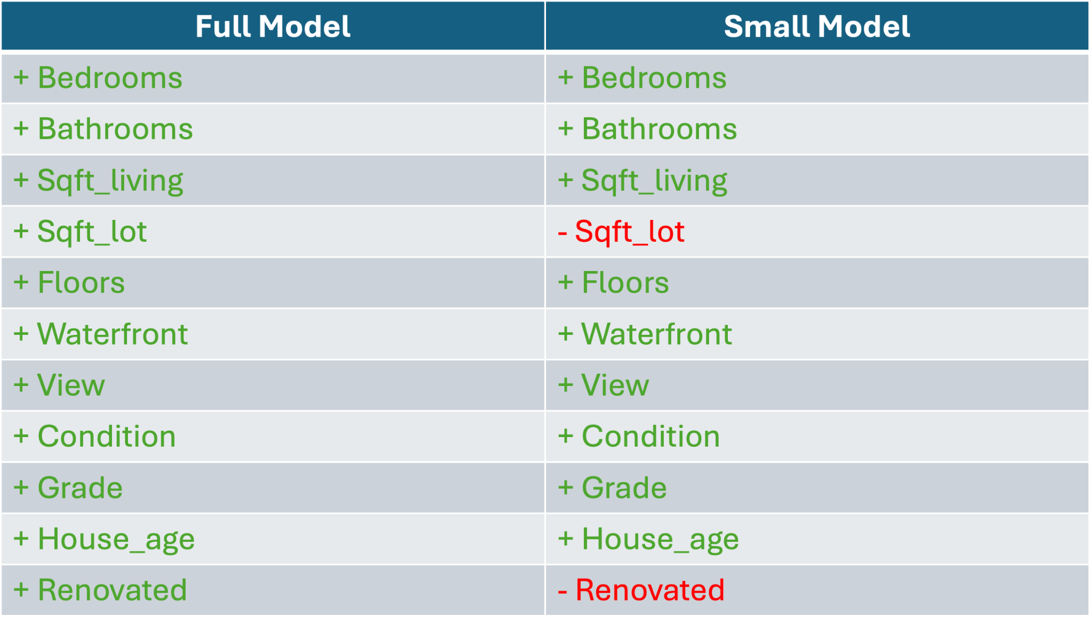
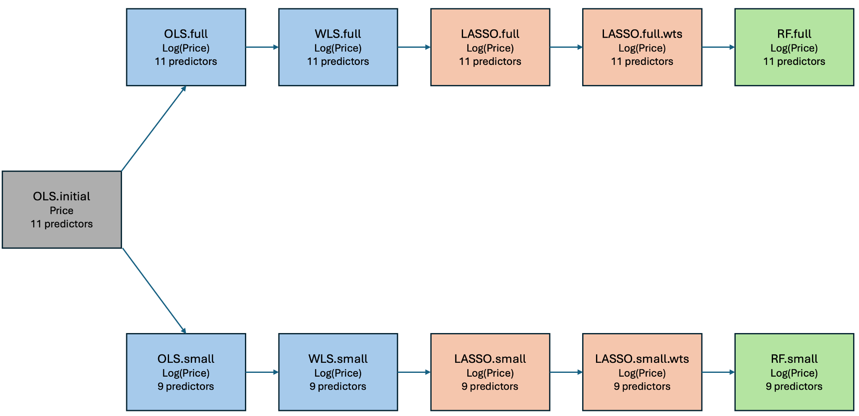
Model Selection Process
Modeling Methods:
OLS/WLS
LASSO
Random Forests
Specifications:
Log(Price)
Variable selection
Business knowledge
Stepwise

Slide 16
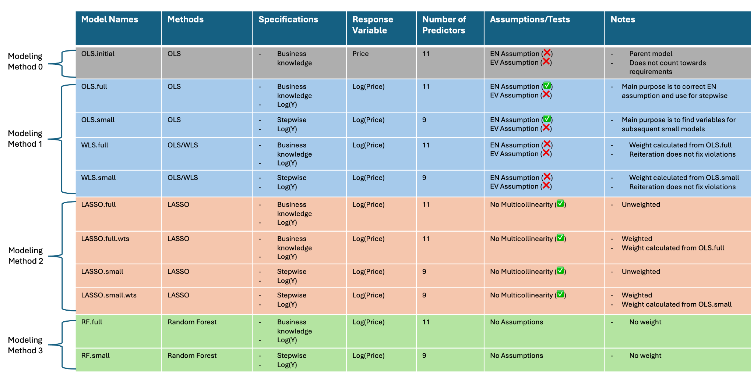
Model Selection Table

Slide 17
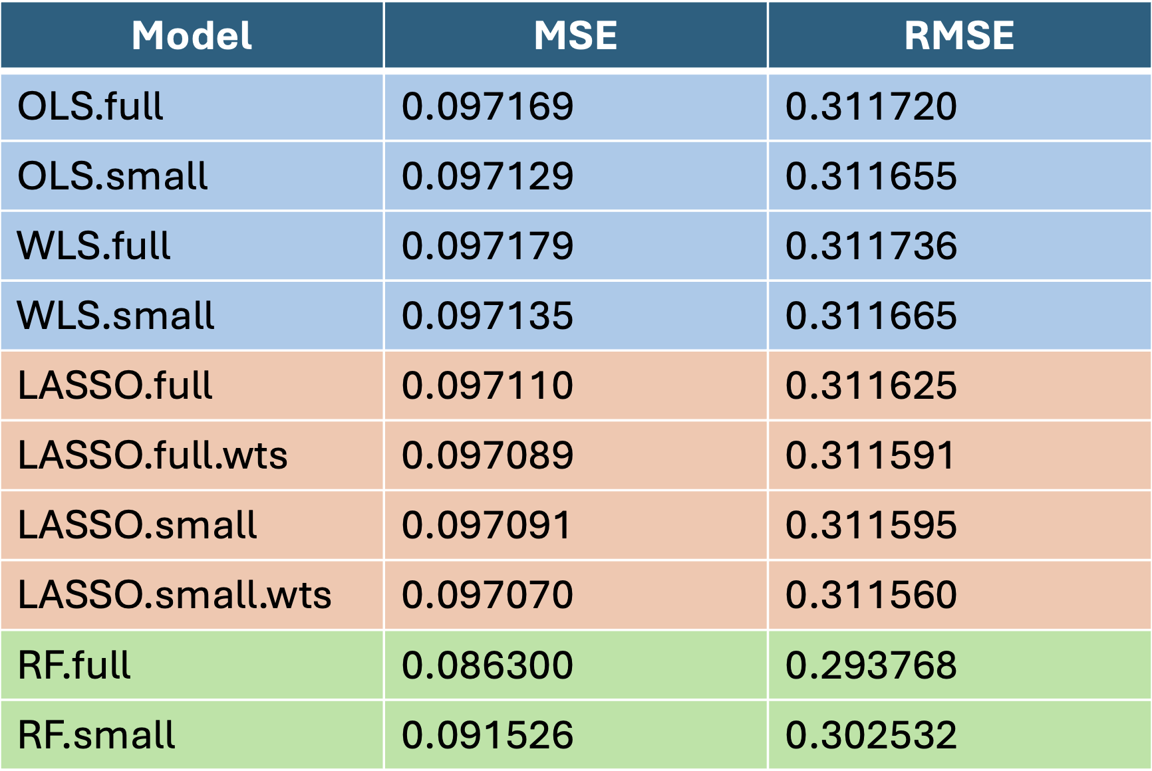
10-Fold Cross Validation Testing Results
Final Models:
Predictive Accuracy
RF.full
Interpretation
OLS.small

Slide 18
06.
Analysis of Results

Slide 19
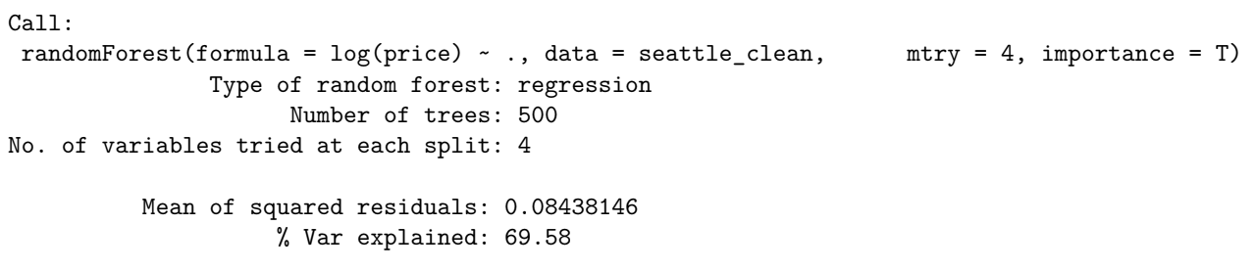
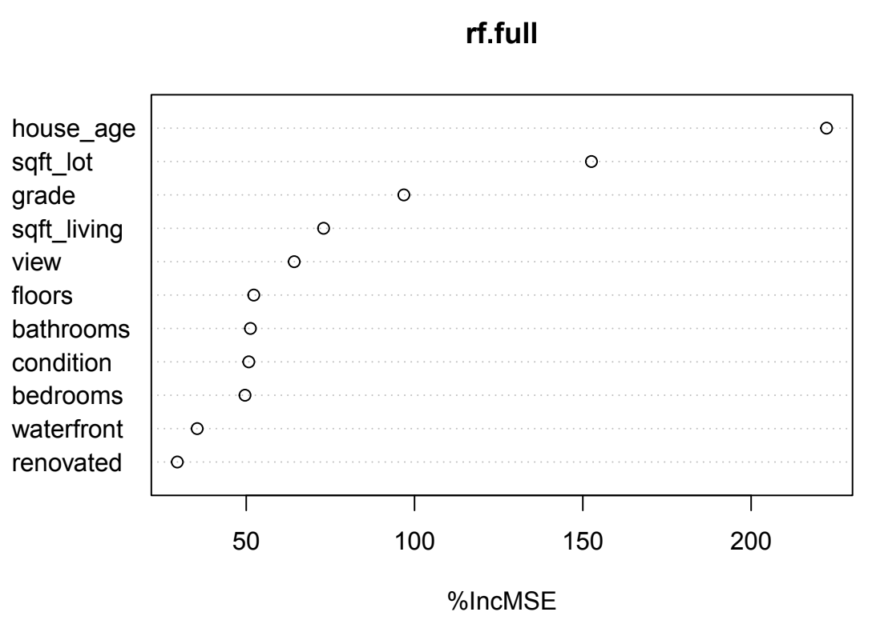
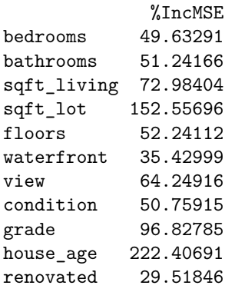
RF.full
Explains ~70% of the variance in house prices
Most influential predictors:
House_age
Sqft_lot
Grade

Slide 20
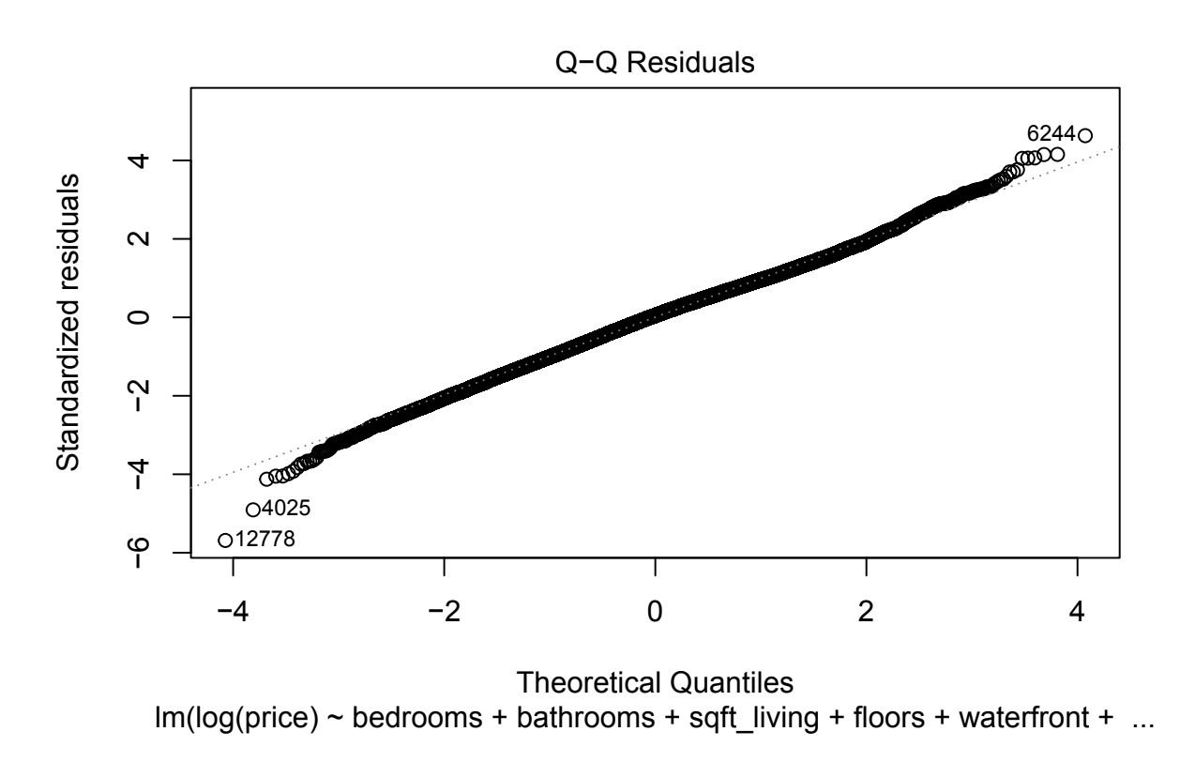
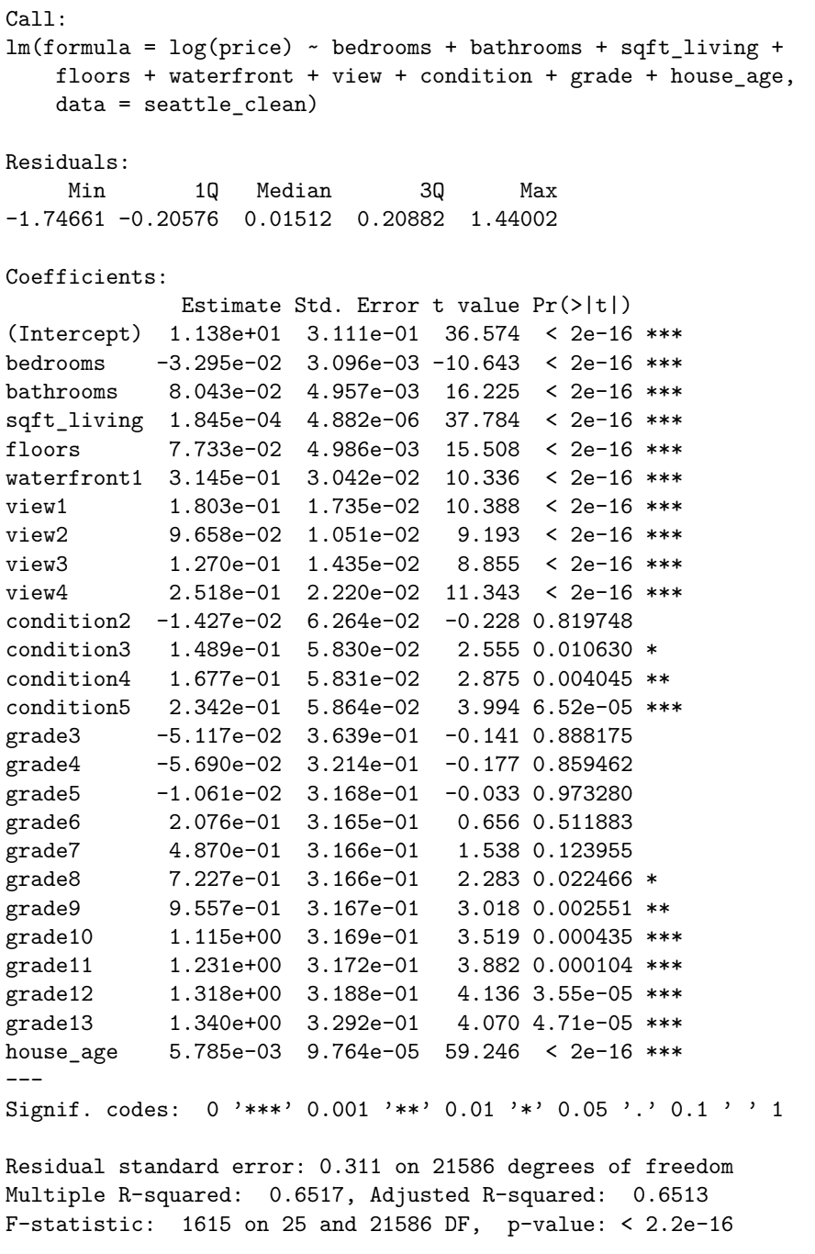
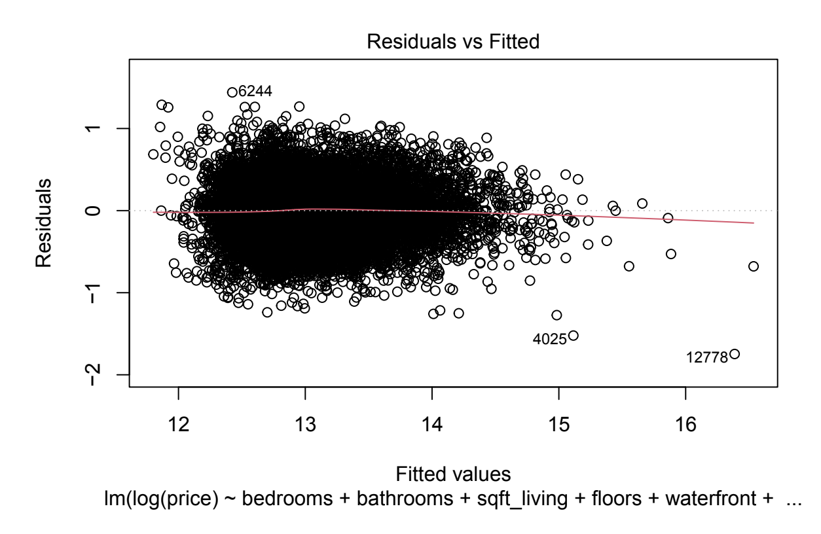
OLS.small
Explains ~65% of the variance in house prices
Assumptions:
Normal distribution of errors ✅
Homoscedasticity ❌
Significant predictors:
All quantitative predictors
Waterfront
All levels of view
Condition (3-5)
Grade (8-13)
Non-significant predictors:
Condition (2)
Grade (3-7)

Slide 21
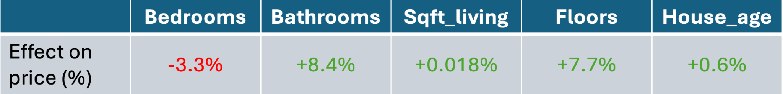
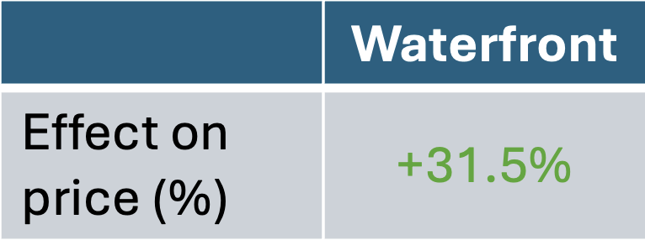
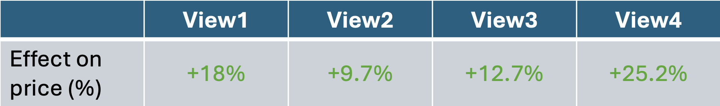
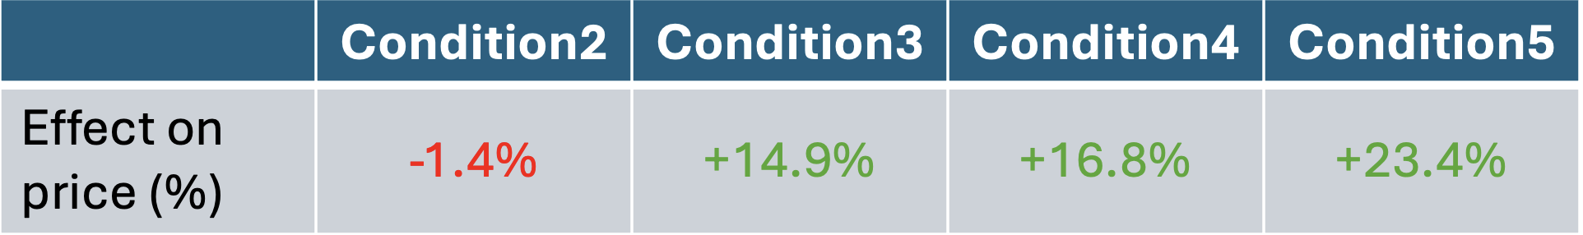

OLS.small (Interpretations) “On average and holding all other variables constant…”
In comparison to houses without waterfronts
In comparison to houses with View0
In comparison to houses with Condition1
In comparison to houses with Grade1

Slide 22
07.
Conclusions

Slide 23



For those looking to sell a house in Seattle, the most important home features to consider when predicting the sales price are:
Age of the house (house_age)
Size of the entire property (Sqft_lot)
Appraisal grade (Grade)

Slide 24
08.
Challenges & Lessons Learned

Slide 25
Challenges:
Addressing violated assumptions in initial OLS models
Coding errors in RStudio (e.g., 10-fold cross validation on WLS models)
Lessons Learned:
OLS models are valuable even if assumptions are violated

Slide 26


Thank You!
Questions?

